Slide 1

Friday 01/30/2025
VIJAY SURESH
Digital Analyst – Simulation

Slide 2
SUMMARY
SETBACK
1
2
3
RECOMMENDATION
4
CONCLUSION

Slide 3
SUMMARY
1

Slide 4
The table displays a summary of video metrics for various platforms in most categories.
SUMMARY
Metric | Highest Value | Lowest Value
Video UV | 8,751,978 (Sep 2017) | 5,614,882 (Jul 2017)
Google Video Starts | 5,898,184 (Sep 2017) | 1,469,873 (Jul 2017)
Facebook Video Starts | 6,007,027 (Jan 2017) | 1,348,002 (Oct 2017)
Google Referrals | 59,800,983 (Sep 2017) | 23,866,833 (Apr 2017)
Facebook Referrals | 82,661,565 (Jan 2017) | 24,591,146 (Oct 2017)
Video Ad Starts | 10,996,508 (Sep 2017) | 7,125,834 (Jul 2017)
Video Starts by Site Area | wp - posttv: 8,321,865 (Sep 2017) | wp - nocategory: 1,648 (Apr 2017)
Video Starts by Referrer Type | Google: 59,800,983 (Sep 2017) | Google: 24,403,447 (Jul 2017)

Slide 5
The table displays a summary percentage change of video metrics for various platforms in most categories.
SUMMARY
Metric | Highest % Change | Lowest % Change
Total Video Starts | +44.6% (Sep 2017 vs. Jul 2017) | -30.8% (Jul 2017 vs. Jun 2017)
Video UV | +55.9% (Sep 2017 vs. Jul 2017) | -23.2% (Oct 2017 vs. Sep 2017)
Google Video Starts | +301.3% (Sep 2017 vs. Jul 2017) | -57.9% (Oct 2017 vs. Sep 2017)
Facebook Video Starts | +16.7% (May 2017 vs. Apr 2017) | -31.2% (Oct 2017 vs. Sep 2017)
Google Referrals | +145.0% (Sep 2017 vs. Jul 2017) | -16.1% (Oct 2017 vs. Sep 2017)
Facebook Referrals | +168.1% (May 2017 vs. Apr 2017) | -12.1% (Oct 2017 vs. Sep 2017)
Video Ad Starts | +60.2% (Aug 2017 vs. Jul 2017) | -7.3% (Oct 2017 vs. Sep 2017)
Video Ad Completes | +63.1% (Aug 2017 vs. Jul 2017) | -15.4% (Oct 2017 vs. Sep 2017)
Video Ad Skips | +125.5% (Apr 2017 vs. Mar 2017) | -15.4% (Oct 2017 vs. Sep 2017)
Video Starts (No Pre-roll) | +319.0% (Oct 2017 vs. Sep 2017) | -53.1% (Jul 2017 vs. Jun 2017)

Slide 6
SETBACK
2
RECOMMENDATION
3
4
CONCLUSTION

Slide 7
SETBACK
2

Slide 8
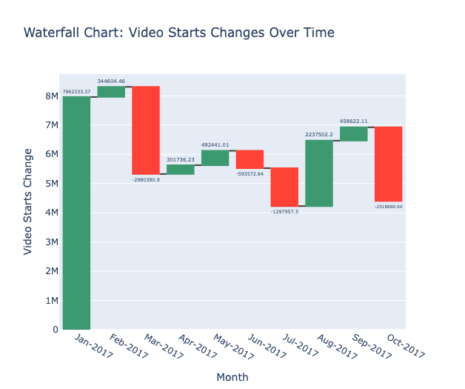
The percentage change in video starts for showing significant fluctuations experiencing a sharp decline in October.
SETBACK

Slide 9
The Significant drivers of drop in Video Starts in October compared to September.
SETBACK
Unique Views
Referrals
Video Platform
News categories
Search engine

Slide 10
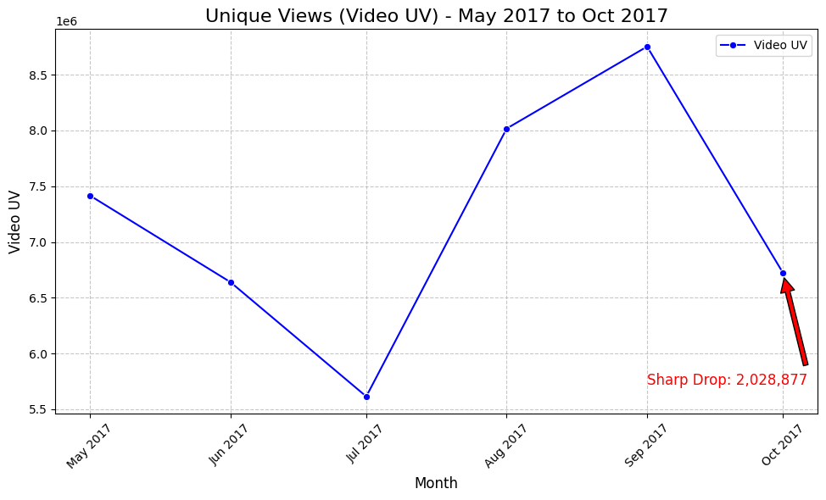
The graph shows a sharp drop in video unique views (UV) from September 2017 to October 2017. The unique views had a percentage dip of approximately 22.6% from September to October.
SETBACK
Unique Views

Slide 11
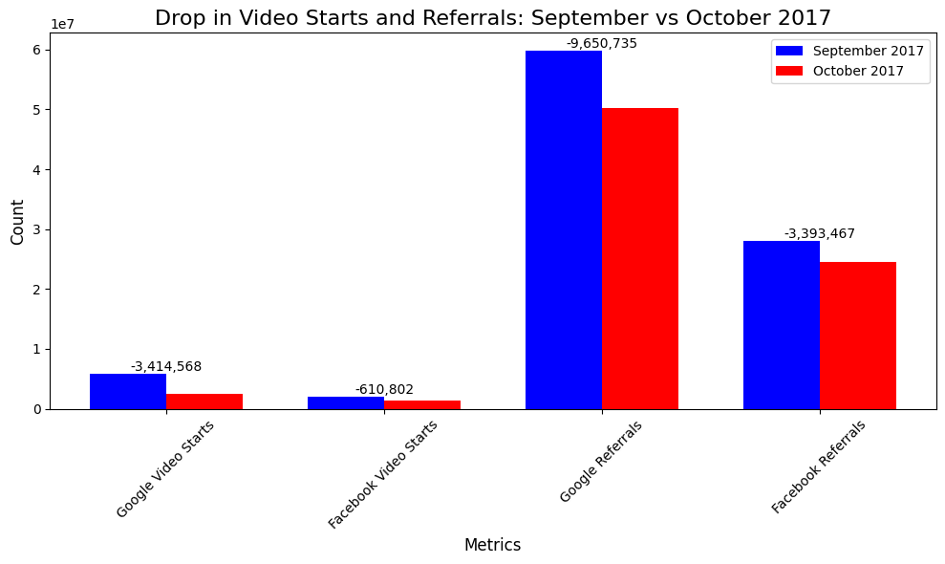
Significant Decline: Both video starts and referrals dropped significantly from September to October 2017
SETBACK
Referrals
Google Video Starts
September: 5,898,184
October: 2,483,616
Drop: 3,414,568 (58% decrease)
Facebook Video Starts:
September: 1,958,804
October: 1,348,002
Drop: 610,802 (31% decrease)

Slide 12
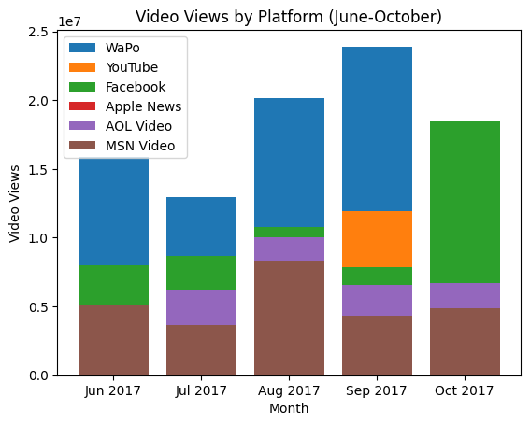
The graph shows a dip in video views in October 2017, and can be inferred that the from September to October YouTube views dropped by 75.8% and WaPo views dropped by 23.4%
SETBACK
Video Platform

Slide 13
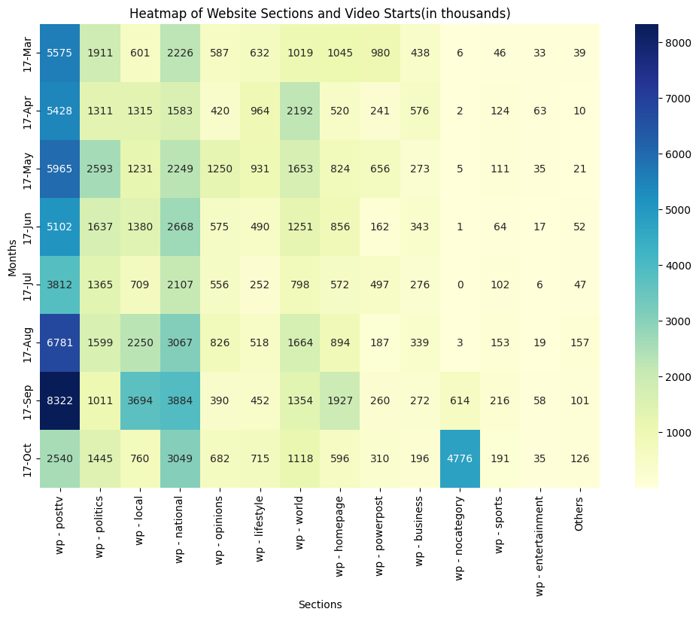
The Visualization shows the decline in views for PostTV, Local, and National in October compared to other Months
SETBACK
Unique Views

Slide 14
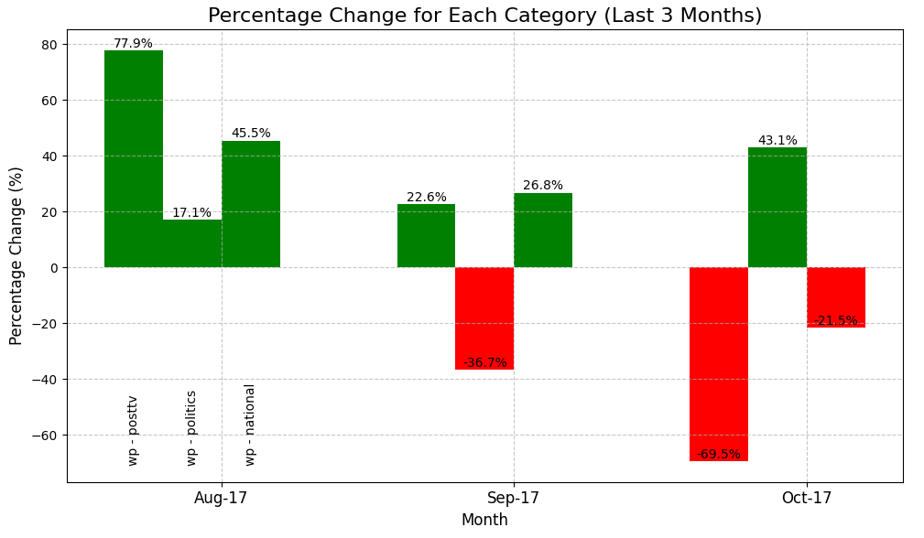
The graph highlights significant fluctuations in video start percentage changes across three news categories over the last three months.
SETBACK
News categories

Slide 15
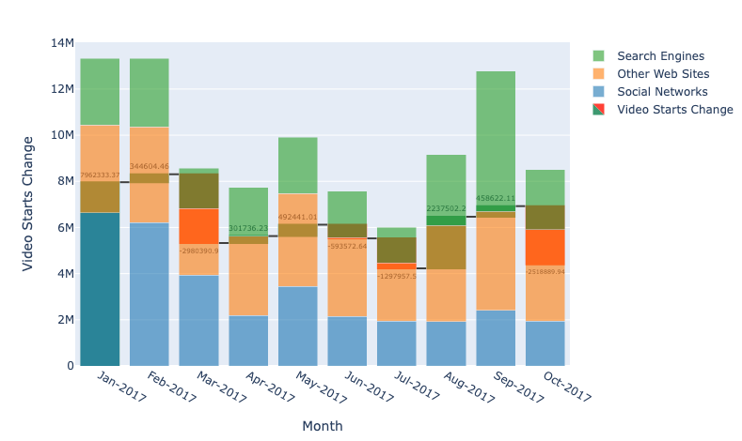
The graph shows percentage change for Search Engines from September to October 2017which is a decline of approximately 57.6. For Other Web Sites, the decline is approximately 11.5%
SETBACK
Search engine

Slide 16
RECOMMENDATION
3
4
CONCLUSTION

Slide 17
RECOMMENDATION
3

Slide 18
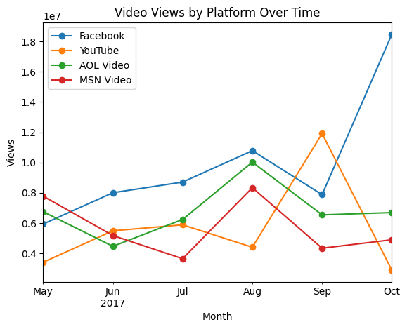
Need to optimize content for these Youtube, Facebook.
RECOMMENDATION
Trend
Revitalize YouTube Strategy by optimizing video titles, descriptions, and tags for better discoverability.
Capitalize on Facebook's strong performance by creating more engaging, short-form videos tailored for the platform

Slide 19
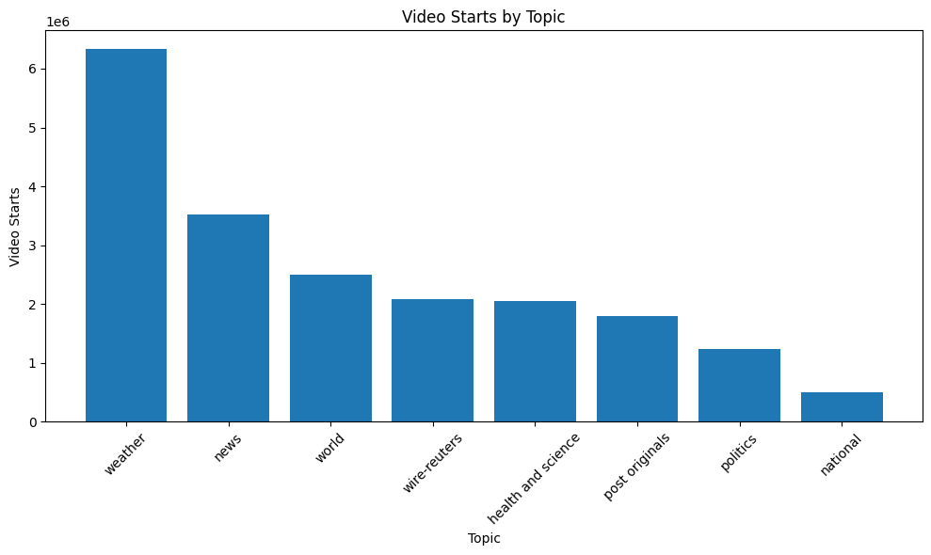
Concentrate on weather, news, and world topics, The Post can leverage its strengths to drive higher video engagement and grow its audience
RECOMMENDATION
Topics
Invest in high-quality weather updates, forecasts, and interactive features.
Highlight global events and trends that resonate with the audience.
Allocate more resources to the top-performing topics

Slide 20
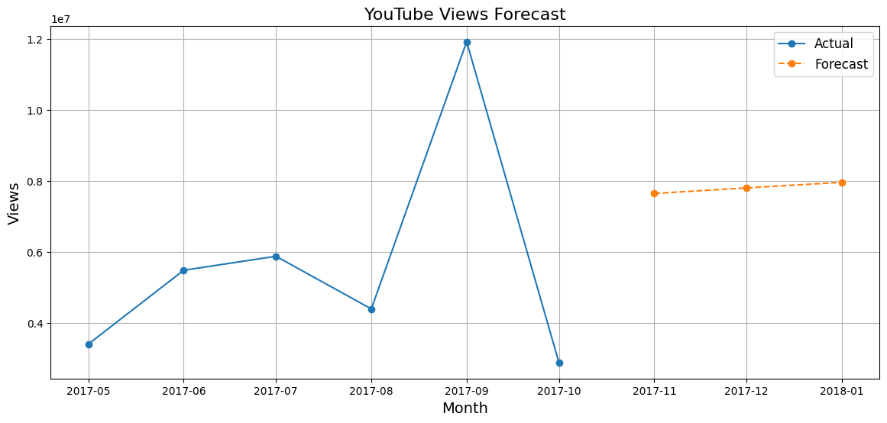
Recommendations to Increase YouTube Views
RECOMMENDATION
YouTube
Focus on creating informative, entertaining, and relevant content that resonates with your target audience.
Continuously monitor YouTube Analytics and adapt to changes in viewer behavior and algorithm updates.

Slide 21
Analyze user behavior and revamp the homepage to increase engagement
RECOMMENDATION
Improve Website Area
Site Area | September 2017 | October 2017 | Change | % Change
Homepage | 1,953,178 | 489,485 | -1,463,693 | -74.9%
Article Pages | 13,146,558 | 11,046,243 | -2,100,315 | -16.0%
Video Pages | 2,708,824 | 2,090,693 | -618,131 | -22.8%
Others | 5,054,220 | 3,191,522 | -1,862,698 | -36.9%
Enhance article content, structure, and search engine optimization (SEO)
Conduct regular user behavior analysis to identify trends, preferences, and pain points.

Slide 22
4
CONCLUSTION

Slide 23
4
CONCLUSTION

Slide 24
CONCLUSION
While Video Ad Completes increased by 15.9%, the overall decline in traffic and ad starts highlights the need for more engaging and relevant video content.
The 23.2% drop in Video UV (Unique Visitors) was the most significant factor, indicating fewer users visited video content in October.
Stay updated on Google and Facebook algorithm changes to improve visibility and engagement.
The drop in Video Starts in October 2017 was driven by a combination of reduced traffic on wp website and YouTube, algorithm changes on Google and Facebook, and a shift in ad strategy.
By addressing these issues and focusing on content quality in YouTube and focus traffic diversification, and ad strategy optimization The Washington Post can recover from the decline and grow its video business in the future.

Slide 25
Thank you

